Slide 1
Tdap: The Whooping Cough Vaccine
What Every Mother-to-be Needs to Know
Notes:
Presentation for inmates

Slide 2
What is Whooping Cough?
Whooping cough, also called pertussis, is an illness that can cause your child to have a terrible cough.
In some cases, it can even cause babies to stop breathing.
Photo credit: http://qsota.com/baby-coughing-at-night-during-sleep/
Notes:
Source: http://www.cdc.gov/pertussis/pregnant/hcp/patient-faqs.html

Slide 3
Traditional Signs of Whooping Cough
Whooping cough seems like a cold at first. Your child can experience coughing, sneezing, runny nose and a low fever.
Children will cough nonstop and have trouble breathing
For kids, the cough often has a “whoop” sound:
Photo Credit: http://www.myvmc.com/videos/coughing-children/
Notes:
Find source

Slide 4
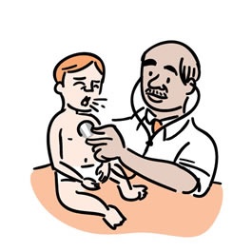
But whooping cough in babies is different and more dangerous
Babies also show cold symptoms but they might not cough; they can simply stop breathing.
Tiny babies aren’t strong enough to cough through the mucus
They can turn blue from lack of air
Photo credit: http://www.searchamelia.com/how-to-whip-whooping-cough-preventing-pertussis
Notes:
Video of pertussis: (will find)

Slide 5
How bad is it for babies?
Babies less than one year old are at greatest risk of dying
About half of babies younger than one year old who get whooping cough have to go to the hospital, and 10-20 babies die from it every year.
Infants are more likely to have other complications from whooping cough, such as brain damage
Notes:
Source: http://www.cdc.gov/pertussis/pregnant/hcp/patient-faqs.html

Slide 6
Why is Whooping Cough a Problem?
Whooping cough is becoming more common in Georgia and throughout the United States.
This makes it more likely that you or your baby could catch the illness.
What can you do?
Notes:
Source: http://www.cdc.gov/pertussis/pregnant/hcp/patient-faqs.html

Slide 7
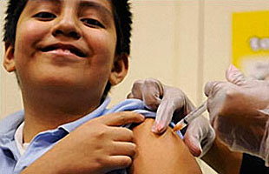
Preventing Whooping Cough
Vaccinations against whooping cough are the best way to protect yourself
What is a vaccine?
A vaccine is a shot that helps the body prevent sickness
You must get a vaccine BEFORE you get sick
Photo credit: http://www.who.int/influenza/vaccines/en/
Notes:
Source: http://www.vaccines.gov/basics/prevention/index.html

Slide 8
Preventing Whooping Cough
Babies should get their first shot for whooping cough when they are 2 months old.
Before 2 months, they are very vulnerable but still too young to get shots.
Photo credit: http://www.cdc.gov/pertussis/outbreaks/about.html
Notes:
Source: http://www.cdc.gov/pertussis/pregnant/hcp/patient-faqs.html

Slide 9
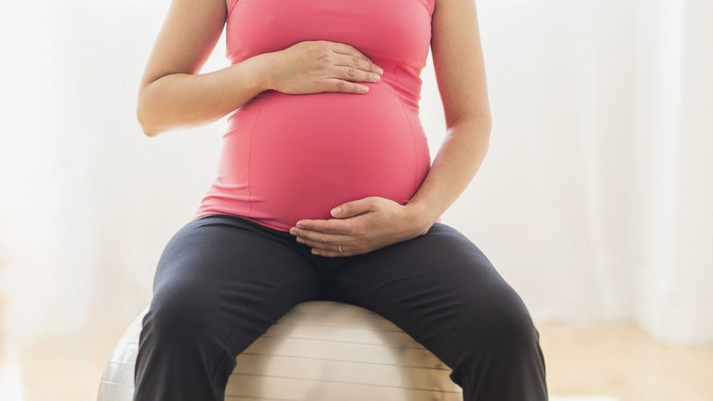
Preventing Whooping Cough
You can protect your baby during the first 2 months by getting the whooping cough shot while you are pregnant.
Your body’s response to the vaccine helps protect your fetus.
Photo credit: http://abcnews.go.com/topics/lifestyle/health/whooping-cough.htm
Notes:
Source: http://www.cdc.gov/pertussis/pregnant/hcp/patient-faqs.html
Photo credit: http://abcnews.go.com/topics/lifestyle/health/whooping-cough.htm

Slide 10
How vaccines during pregnancy work
When you get a shot during pregnancy, your body makes antibodies to protect you from getting the actual disease
These antibodies pass to your baby in your belly and they last long enough to protect your baby until he or she can get a shot

Slide 11
About the Tdap Vaccine
The shot that prevents whooping cough in adults is called Tdap. Tdap stands for Tetanus, Diphtheria, and Pertussis, which are the three diseases that the shot protects against.
It is important to get the Tdap shot during your last three months of pregnancy: this will make sure that your baby gets the most benefit from it.
The vaccine doesn’t protect you for that long, so you should get one during every pregnancy even if you’ve had it before.
Notes:
Find source

Slide 12
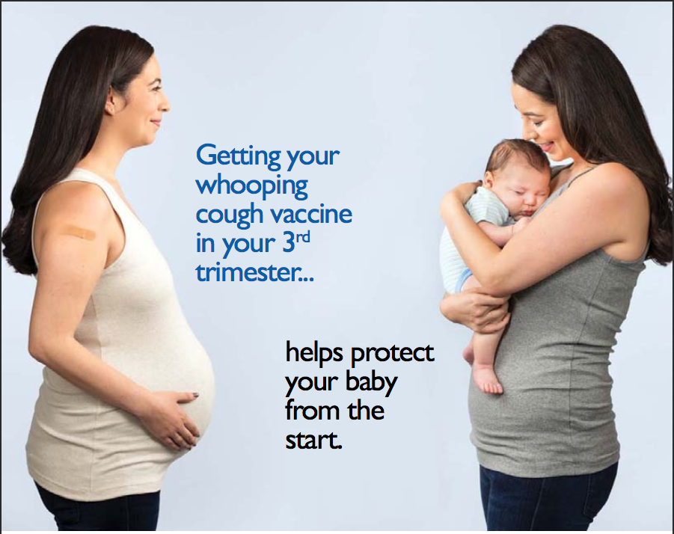
Notes:
There are many things that a pregnant woman can do to protect her baby, even before it is born. One of the most important things you can do is to get the whooping cough vaccine during your third trimester (last three months) of pregnancy.
Picture from: http://www.cdc.gov/pertussis/downloads/p-before-after-protect.pdf

Slide 13
Common Questions
How do I take the vaccine?
The shot is given as a single shot, usually into your upper arm muscle.
Is the shot safe?
Yes! This shot has a great safety history. It has not been shown to cause any major problems for mothers or their babies. Some people may have a little redness or swelling after the injection, which will go away on its own.

Slide 14
Common Questions
Is it ok to breastfeed after getting the shot?
Yes! Breastfeeding after the shot is completely safe, and can help protect your baby even more.
Antibodies can pass through breast milk too!
Can I wait until after giving birth to get the shot?
It’s important to get the shot while you’re still pregnant. If you wait until after your baby is born to get it, the shot will protect you from whooping cough but it will not protect your baby.

Slide 15
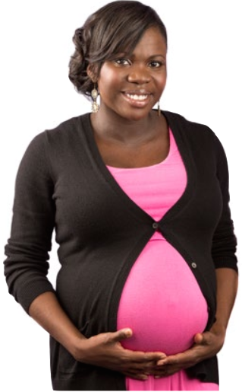
More Questions?
Ask your doctor if you have other questions or concerns! They can help you make the best decision for you and your baby.
Notes:
Picture from: http://www.cdc.gov/pertussis/downloads/fs-protecting-before-birth.pdf

